Slide 1
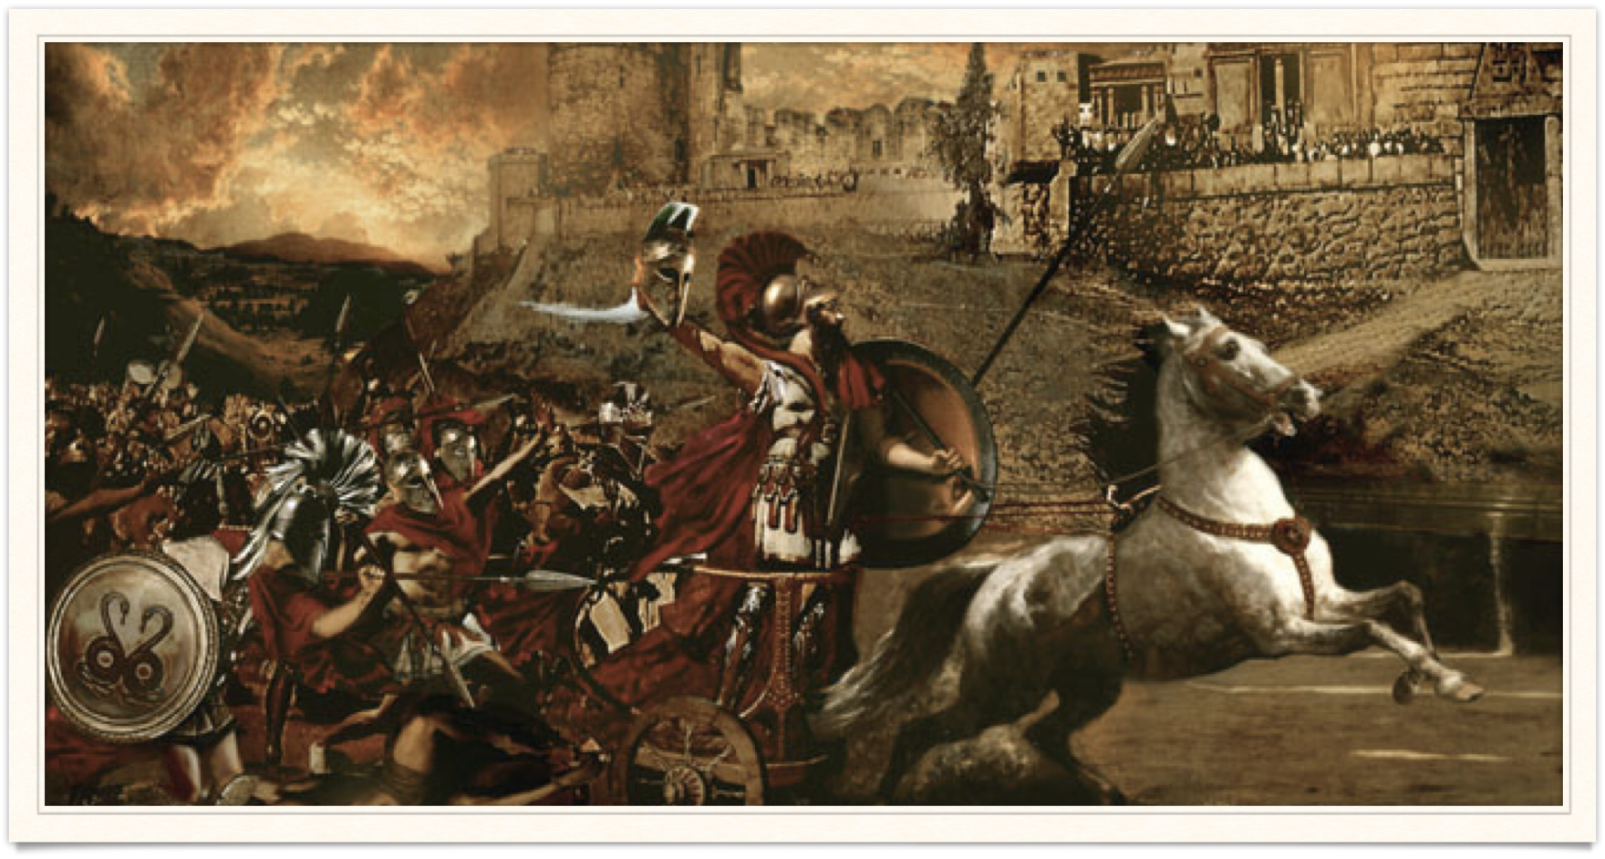
Telling the story
Goal/s:
Identify and describe the story of the trojan war from homer’s illiad
Week 5 Lesson 4
Ms Barrie

Slide 2
Assessment 2
For your next task, you will be required to COMPARE and CONTRAST the story of the Troy and the Trojan War from Homer’s Illiad and the film Troy.
Both stories have different series of events and depictions of characters.
You will be then be required to write an essay with the following body paragraphs:
1. Background to the Trojan War (who, what, when, where, why?)
2. Similarities between two texts (COMPARE)
3. Differences between two texts (CONTRAST)

Slide 3
Today’s Lesson
Complete the research sheet about depictions of the Trojan War in Homer’s Iliad.

